Slide 1
Image and Video Processing

Slide 2
III.3.10 Basic Methods for Motion Detection
1 Introduction
2 Frame Difference
2.1 Scale filter
2.2 Three-frame difference
2.3 Accumulative difference picture
3 Background Subtraction
3.1 Simple background modeling
3.2 GMM based background subtraction
4 Optical Flow Field
4.1 Horn-Schunck algorithm
4.2 Lucas-Kanade algorithm

Slide 3
1.Introduction
What is motion detection? -Whether image points are moving or not?
Motion detection is the process of detecting a change in the position of an object relative to its surroundings or a change in the surroundings relative to an object.
What’s the reason for motion detection?
In motion analysis, the main task of motion detection is to detect moving targets. It lays the foundation for subsequent motion feature extraction and recognition.
What are the basic methods?
Frame difference, Background subtraction, Optical flow field.

Slide 4
Motion Detection
Goals of motion detection
Identify moving objects
Detection of unusual activity patterns
Computing trajectories of moving objects
Applications of motion detection
Indoor/outdoor security
Real time crime detection
Traffic monitoring
Many intelligent video analysis systems are based on motion detection.

Slide 5
Hypothesis Testing with a Fixed threshold
Let H_{M} and H_{S} be two hypotheses declaring an image point at n as moving (M) and stationary (S), respectively.
Let
We can write the hypothesis test as follows:

Slide 6
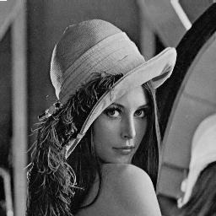
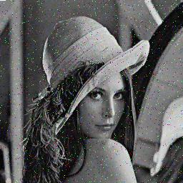
Hypothesis Testing with a Fixed threshold
Original
Noise
Stationary but ρ>θ in many places.

Slide 7
Hypothesis Testing with a Fixed threshold
How to handle noise:
where W is a spatial windows.

Slide 8

Hypothesis Testing with a Fixed threshold
Original
Light
Stationary but ρ>θ.

Slide 9
Hypothesis Testing with a Fixed threshold
Compare intensity gradients to handle illumination change:

Slide 10
III.2 Basic Methods for Motion Detection
1 Introduction
2 Frame Difference
2.1 Scale filter
2.2 Three-frame difference
2.3 Accumulative difference picture
3 Background Subtraction
3.1 Simple background modeling
3.2 GMM based background subtraction
4 Optical Flow Field
4.1 Horn-Schunck algorithm
4.2 Lucas-Kanade algorithm

Slide 11
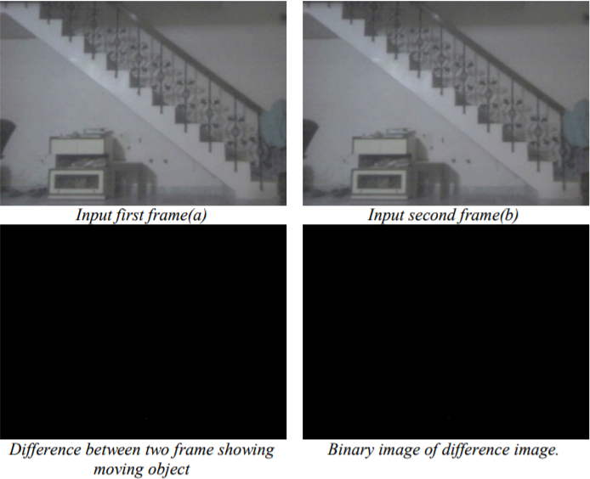
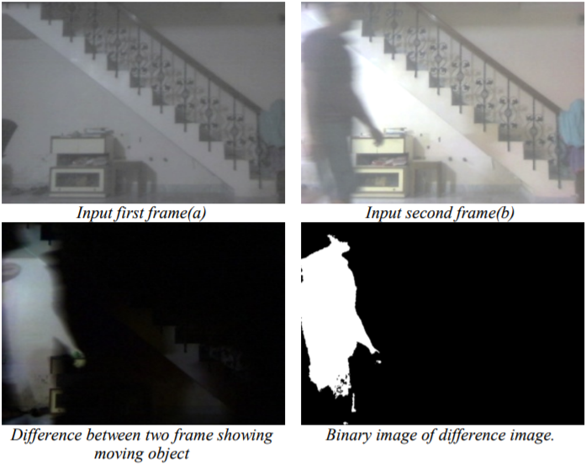
Demo for Frame Difference
Static scene
Dynamic scene

Slide 12
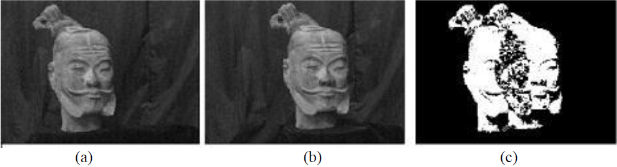
2 Frame Difference
By directly comparing the corresponding gray values of two frames of images, a differential image representing the information of the moving objects in the scene can be obtained
Figure(c) represents the differential image of figure (a) and (b)

Slide 13
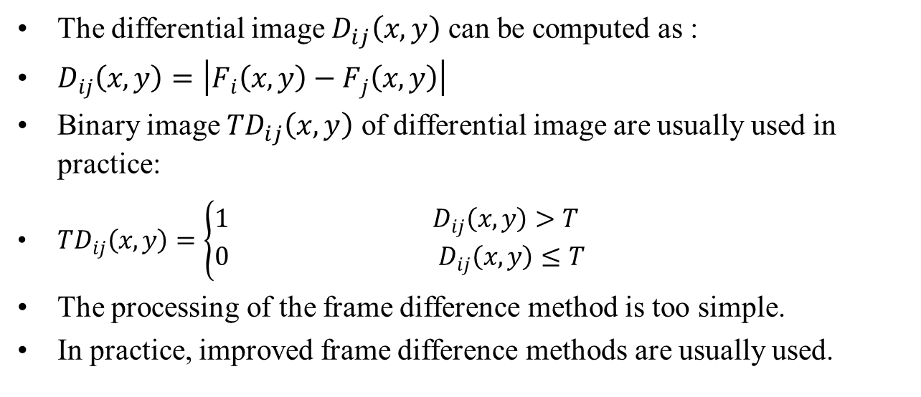
2 Frame Difference
The differential image $D_{ij}\left(x,y\right)$ can be computed as :
$D_{ij}\left(x,y\right)=\left|F_{i}\left(x,y\right)−F_{j}\left(x,y\right)\right|$
Binary image ${TD}_{ij}\left(x,y\right)$ of differential image are usually used in practice:
${TD}_{ij}\left(x,y\right)=\left\{\begin{aligned}1 D_{ij}\left(x,y\right)>T \\ 0 D_{ij}\left(x,y\right)≤T\end{aligned}\right.$
The processing of the frame difference method is too simple.
In practice, improved frame difference methods are usually used.

Slide 14
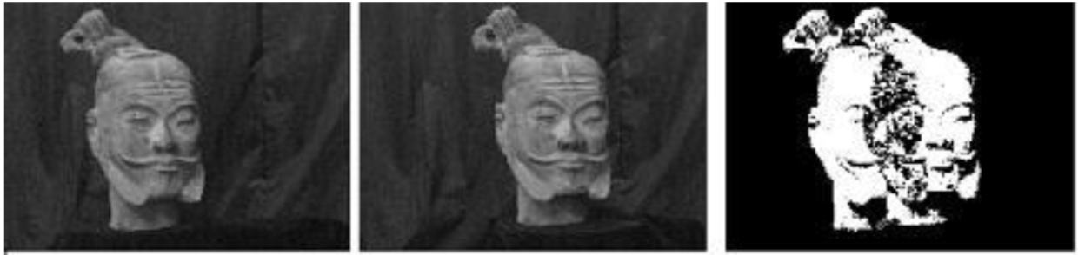
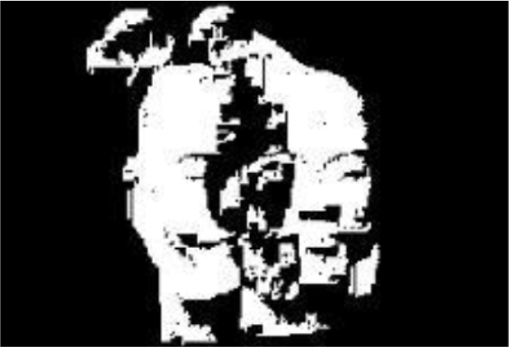
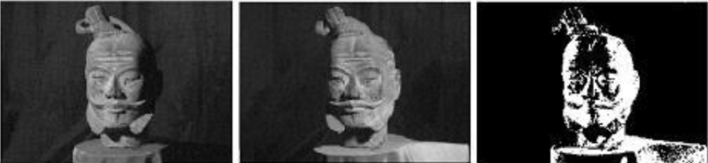
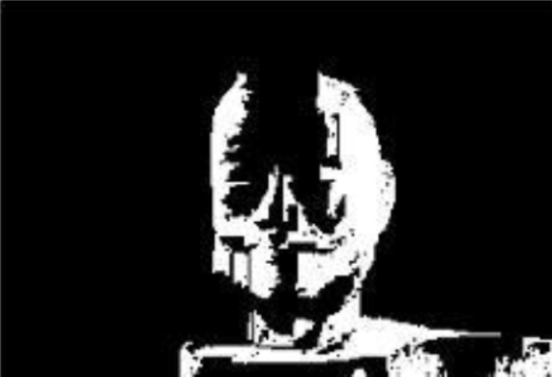
2.1 Scale filter
Binary difference images usually contain a lot of noise. Objects we pay attention to are usually relatively large.
So these noises can be eliminated by a scale filter. Connected components larger than a threshold are retained.
(a) (b) (c) (d)
(c) Binary image (d) filtered binary image

Slide 15
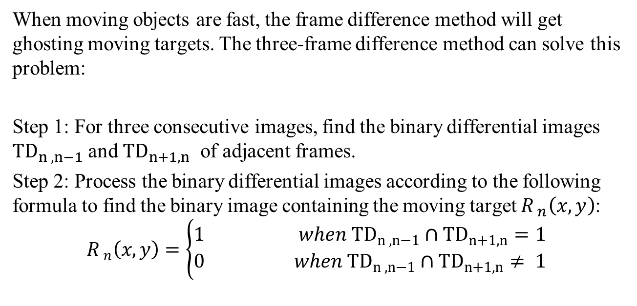
2.2 Three-frame Difference
When moving objects are fast, the frame difference method will get ghosting moving targets. The three-frame difference method can solve this problem:
Step 1: For three consecutive images, find the binary differential images ${TD}_{n ,n−1}$ and ${TD}_{n+1,n}$ of adjacent frames.
Step 2: Process the binary differential images according to the following formula to find the binary image containing the moving target $R_{ n}\left(x,y\right)$:
$$R_{ n}\left(x,y\right)=\left\{\begin{aligned}1 when {TD}_{n ,n−1}∩{TD}_{n+1,n}=1 \\ 0 when {TD}_{n ,n−1}∩{TD}_{n+1,n}≠ 1\end{aligned}\right.$$
Notes:
Ghosting: 重影

Slide 16
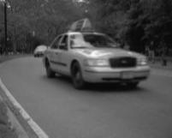
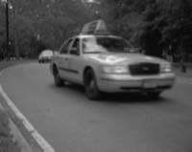
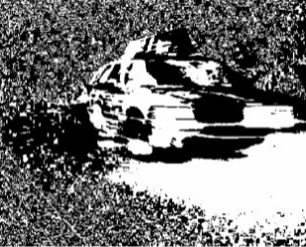
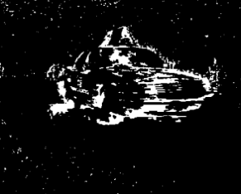
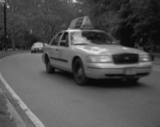
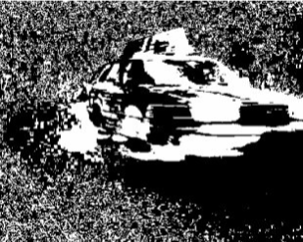
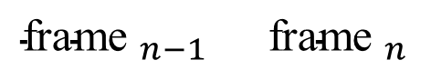
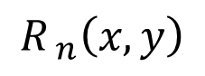
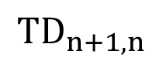
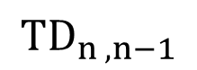
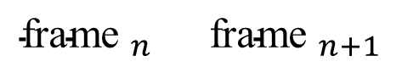
2.2 Three-frame Difference illustration
$${\text{frame} }_{n−1} {\text{frame} }_{n}$$
$${TD}_{n ,n−1}$$
$$R_{ n}\left(x,y\right)$$
$${\text{frame} }_{n} {\text{frame} }_{n+1}$$
$${TD}_{n+1,n}$$
Outline in three-frame differential image is sharper.

Slide 17
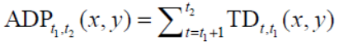
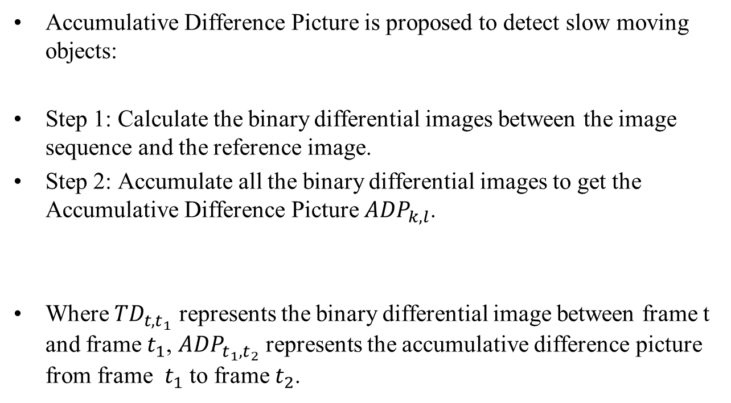
2.3 Accumulative Difference Picture
Accumulative Difference Picture is proposed to detect slow moving objects:
Step 1: Calculate the binary differential images between the image sequence and the reference image.
Step 2: Accumulate all the binary differential images to get the Accumulative Difference Picture ${ADP}_{k,l}$.
Where ${TD}_{t,t_{1}}$ represents the binary differential image between frame t and frame $t_{1}$, ${ADP}_{t_{1},t_{2}}$ represents the accumulative difference picture from frame $t_{1}$ to frame $t_{2}$.

Slide 18
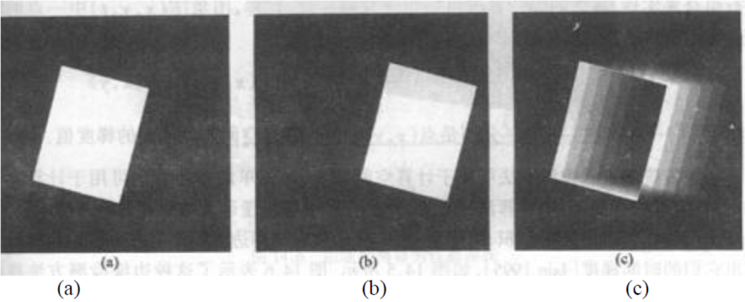
2.3 Accumulative Difference Picture Illustration
(a) The start frame (reference frame)
(b) Accumulative Difference Picture Illustration after the third frame
(c) Accumulative Difference Picture Illustration after the last frame

Slide 19
III.2 Basic Methods for Motion Detection
1 Introduction
2 Frame Difference
2.1 Scale filter
2.2 Three-frame difference
2.3 Accumulative difference picture
3 Background Subtraction
3.1 Simple background modeling
3.2 GMM based background subtraction
4 Optical Flow Field
4.1 Horn-Schunck algorithm
4.2 Lucas-Kanade algorithm

Slide 20
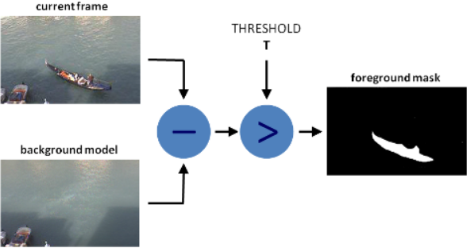
Demo for Background Subtraction

Slide 21
3 Background Subtraction
Background subtraction aims to detect moving objects from the video (image) sequence and reduce the background
It can simplify various video image processing problems, reduce the amount of calculation and model complexity.
The basic process of background subtraction is:
Step 1: Modeling the background
Step 2: Calculating the binary differential image between frame and background

Slide 22
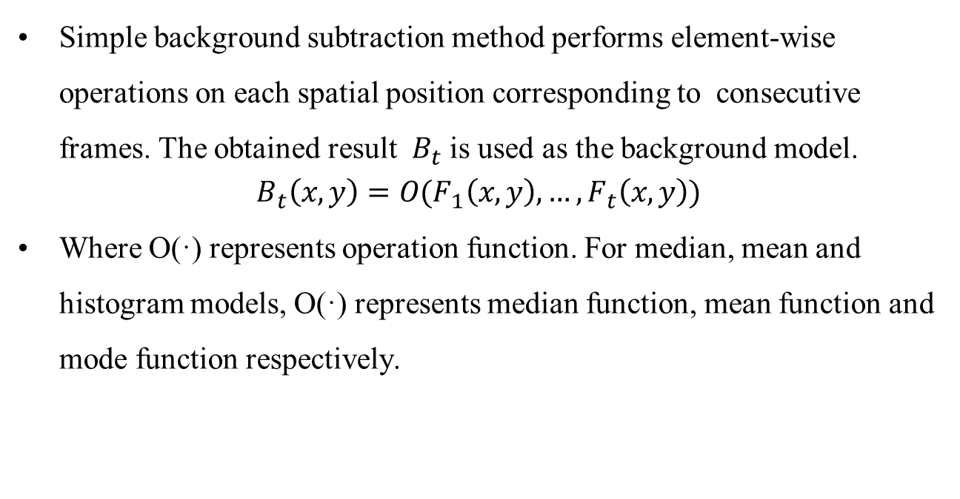
3.1 Simple Background Subtraction
Simple background subtraction method performs element-wise operations on each spatial position corresponding to consecutive frames. The obtained result $B_{t}$ is used as the background model.
$$B_{t}\left(x,y\right)=O(F_{1}\left(x,y\right),…,F_{t}\left(x,y\right))$$
Where O(·) represents operation function. For median, mean and histogram models, O(·) represents median function, mean function and mode function respectively.

Slide 23
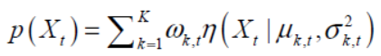
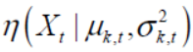
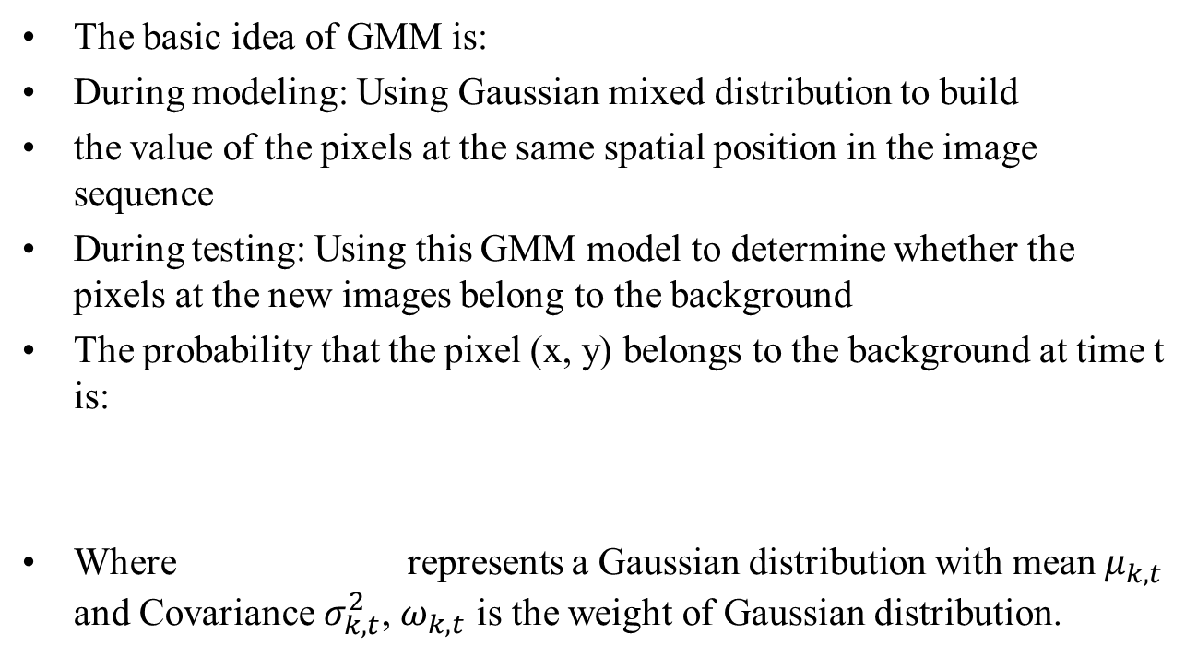
3.2 GMM based background subtraction
The basic idea of GMM is:
During modeling: Using Gaussian mixed distribution to build
the value of the pixels at the same spatial position in the image sequence
During testing: Using this GMM model to determine whether the pixels at the new images belong to the background
The probability that the pixel (x, y) belongs to the background at time t is:
Where represents a Gaussian distribution with mean $μ_{k,t}$ and Covariance $σ_{k,t}^{2}$, $ω_{k,t}$ is the weight of Gaussian distribution.

Slide 24
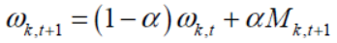
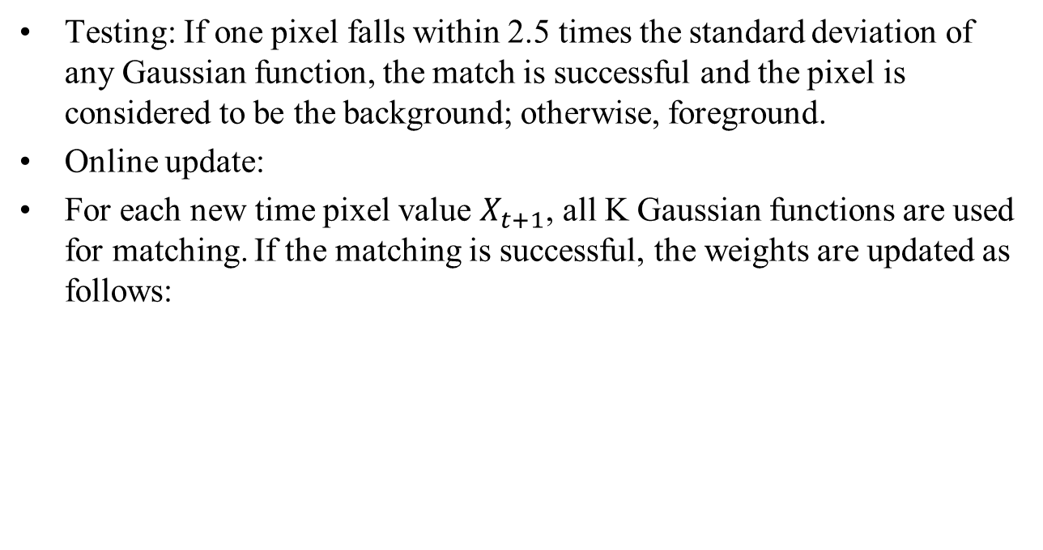
3.2 GMM based background subtraction
Testing: If one pixel falls within 2.5 times the standard deviation of any Gaussian function, the match is successful and the pixel is considered to be the background; otherwise, foreground.
Online update:
For each new time pixel value $X_{t+1}$, all K Gaussian functions are used for matching. If the matching is successful, the weights are updated as follows:

Slide 25
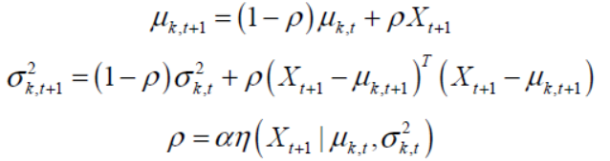
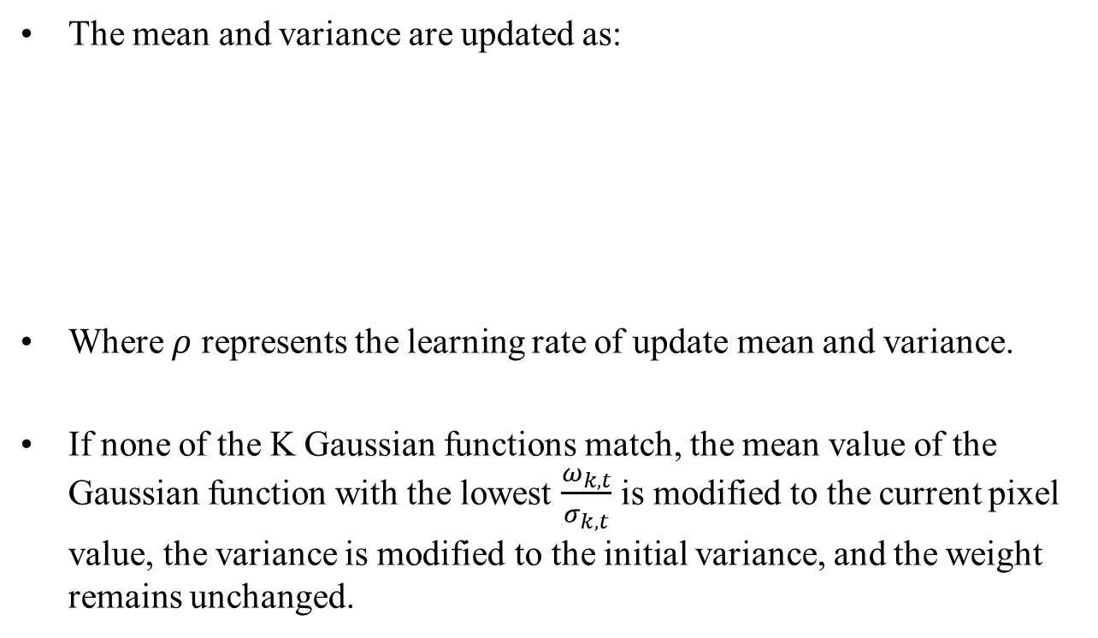
3.2 GMM based background subtraction
The mean and variance are updated as:
Where $ρ$ represents the learning rate of update mean and variance.
If none of the K Gaussian functions match, the mean value of the Gaussian function with the lowest $\frac{ω_{k,t}}{σ_{k,t}}$ is modified to the current pixel value, the variance is modified to the initial variance, and the weight remains unchanged.

Slide 26
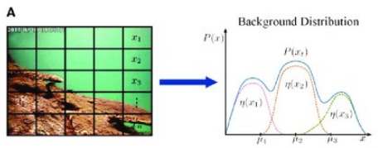
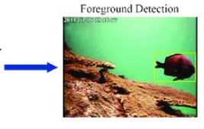
Demo for GMM based background subtraction
Each pixel has an Gaussian mixed distribution
For a pixel in new image , if the pixel value falls within 2.5 times the standard deviation of any Gaussian function, it is considered as background. Otherwise, foreground.

Slide 27
III.2 Basic Methods for Motion Detection
1 Introduction
2 Frame Difference
2.1 Scale filter
2.2 Three-frame difference
2.3 Accumulative difference picture
3 Background Subtraction
3.1 Simple background modeling
3.2 GMM based background subtraction
4 Optical Flow Field
4.1 Horn-Schunck algorithm
4.2 Lucas-Kanade algorithm

Slide 28
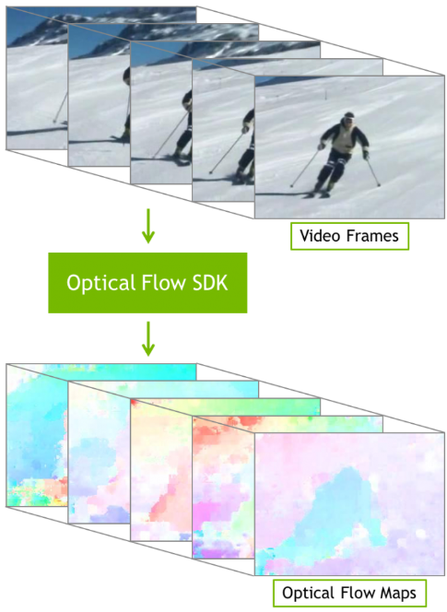
Demo for Optical Flow method

Slide 29
4 Optical Flow Field
Optical flow is the pattern of apparent motion of objects, surfaces and edges in a visual scene caused by the relative motion between an observer and a scene.
Optical flow can also be defined as the distribution of apparent velocities of movement of brightness pattern in an image.
By detecting the change of the brightness of the pixel of the image over time, we can calculate optical flow.

Slide 30
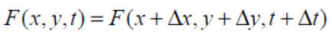
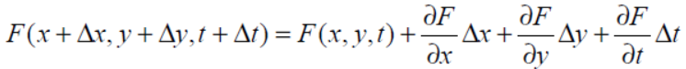
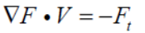
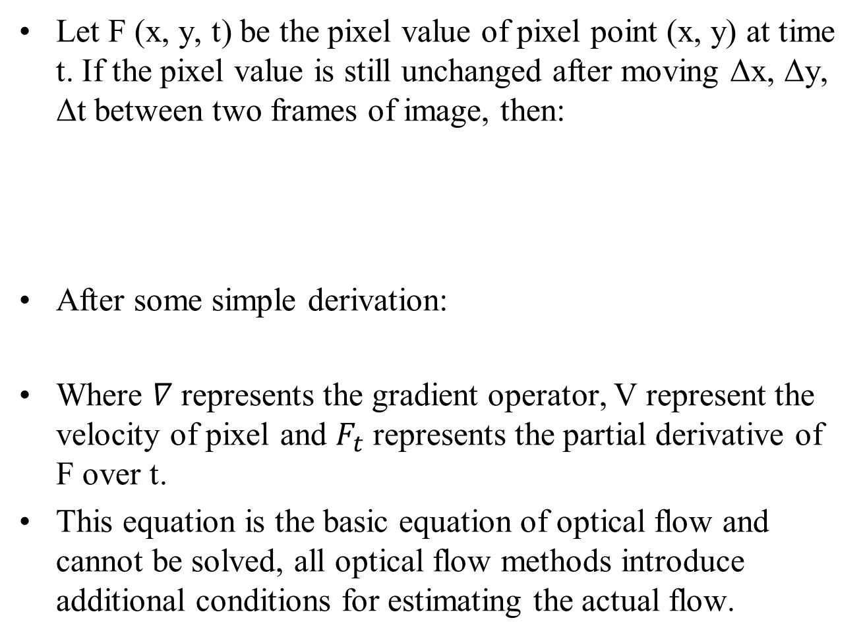
The basic equation of optical flow
Let F (x, y, t) be the pixel value of pixel point (x, y) at time t. If the pixel value is still unchanged after moving Δx, Δy, Δt between two frames of image, then:
After some simple derivation:
Where $∇$ represents the gradient operator, V represent the velocity of pixel and $F_{t}$ represents the partial derivative of F over t.
This equation is the basic equation of optical flow and cannot be solved, all optical flow methods introduce additional conditions for estimating the actual flow.

Slide 31
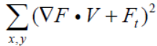
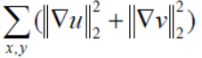
4.1 Horn-Schunck algorithm
The Horn-Schunck algorithm assumes that the optical flow of the entire image is smooth and adds a global smoothing assumption to the basic constraint equation.
Solving the basic constraint equation can be transformed into minimizing the error:
Optical flow smoothing assumptions can be translated to minimize errors:

Slide 32
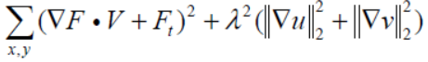
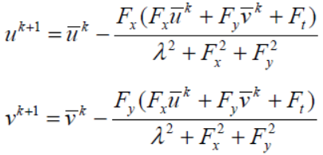
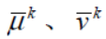
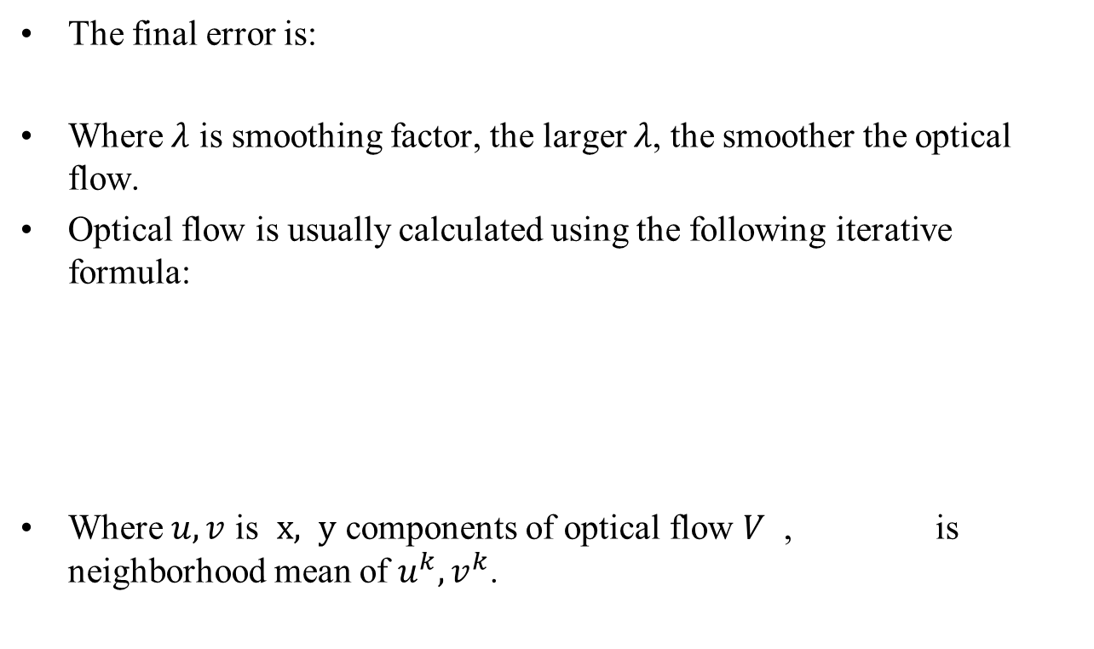
4.1 Horn-Schunck algorithm
The final error is:
Where $λ$ is smoothing factor, the larger $λ$, the smoother the optical flow.
Optical flow is usually calculated using the following iterative formula:
Where $u,v$ is $x, y$ components of optical flow $V$ , is neighborhood mean of $u^{k},v^{k}$.

Slide 33
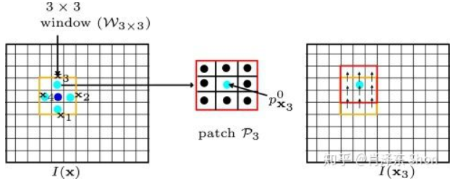
4.2 Lucas-Kanade algorithm
Lucas-Kanade algorithm assumes that the optical flow is essentially constant in a local neighbourhood of the pixel under consideration, and solves the basic optical flow equations for all the pixels in that neighbourhood, by the least squares criterion.

Slide 34
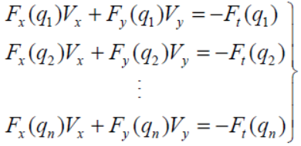
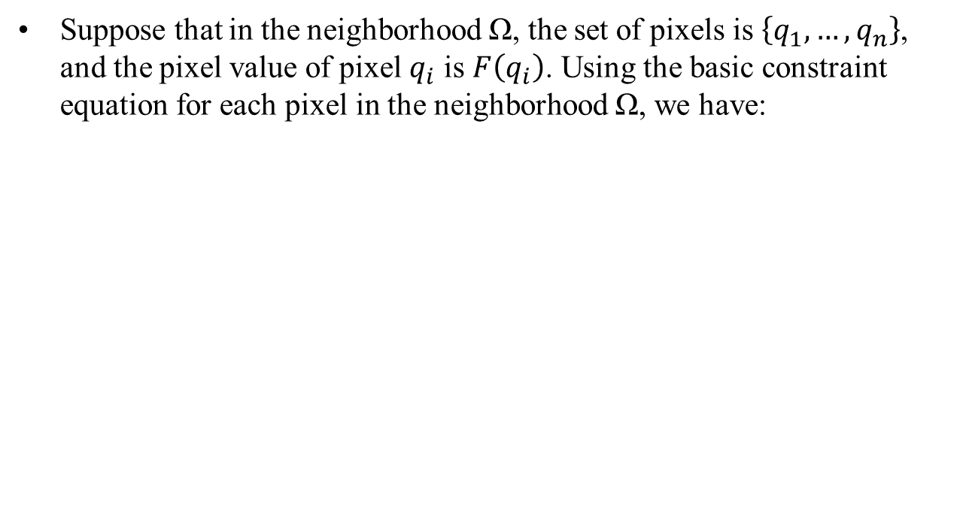
4.2 Lucas-Kanade algorithm
Suppose that in the neighborhood Ω, the set of pixels is $\left\{q_{1},…,q_{n}\right\}$, and the pixel value of pixel $q_{i}$ is $F\left(q_{i}\right)$. Using the basic constraint equation for each pixel in the neighborhood Ω, we have:

Slide 35



4.2 Lucas-Kanade algorithm
Let , the constraint
equation can be written as:
$$Av=b$$
Optical flow v can be solved by least squares:

Slide 36
Motion Estimation

Slide 37
Motion Models
Spatial Motion Models
Temporal Motion Models
Region of Support
Observation Models

Slide 38
Spatial Motion Models
The velocity at position x in the image plane is described by:
When combined with 3-D affine motion of a planar surface, it leads to:

Slide 39
Temporal Motion Models
When the trajectories are linear and the velocity v_{t}(x) is constant between t=t_{k-1} and τ (τ>t), a linear trajectory can be expressed as:
A natural extension of the linear model is a quadratic trajectory model:

Slide 40

Region of Support
The set of points x to which a spatial and temporal motion model applies is called a region of support, denoted R.

Slide 41





the whole image

Slide 42





irregularly shaped region

Slide 43
Observation Models
Let s be a variable along a motion trajectory. Then:
where .

Slide 44
Observation Models
Again, when illumination changes, we use the gradients:

Slide 45
Estimation Criteria
The models discussed have to be incorporated into an estimation criterion that will be subsequently optimized.
Pixel-Domain Criteria
Regularization
Bayesian Criteria

Slide 46
Pixel-Domain Criteria
Minimize the following error:
A common choice for the estimation criterion is the following sum:
where Φ is a nonnegative real-valued function.

Slide 47
Pixel-Domain Criteria
How to choose Φ?

Slide 48
Regularization
A motion field vt must be sought that satisfies the motion constraint
as closely as possible and simultaneously is as smooth as possible. This may be achieved by minimizing the following criterion:
where D is the domain of the image.

Slide 49
Bayesian Criteria
If motion field d_{k} is a realization of a vector random field D_{k} with a given posteriori probability distribution, and image I_{k} is a realization of a scalar random field I_{k}, then the MAP estimate of d_{k} can be computed as follows:

Slide 50
Search Strategies
Once models have been identified and incorporated into an estimation criterion, the last step is to develop an efficient (complexity) and effective (solution quality) strategy for finding the estimates of motion parameters.
Minimizing a prediction error
Gradient-based techniques
Relaxation techniques

Slide 51
Practical Motion Estimation Algorithms
Global Motion Estimation
Block Matching
Phase Correlation
Optical Flow by Means of Regularization
MAP Estimation of Dense Motion

Slide 52


Global Motion Estimation

Slide 53


Slide 54

Block Matching
Block matching uses a spatially constant and temporally linear motion over a rectangular region of support. We can describe the method by the following minimization:
where P is the search area to which d_{m} belongs, defined as follows:
and B_{m} is an M×N block of pixels with the top-left cornet coordinate at m=(m₁,m₂).

Slide 55


Slide 56
Block Matching
Search Methods
An exhaustive search for d_{m}∈P that gives the lowest error ε is computationally costly.
Logarithmic search: Assuming that P=2^{k}-1 and denoting P_{l}=(P+1)/2^{l}, where k and l are integers, we establish the new reduced-size search area as follows:

Slide 57


Slide 58
Block Matching
2-D search vs 1-D search
One-at-a-time search
Parallel hierarchical one-dimensional search
……

Slide 59

Experimental Comparison of Motion Estimation Methods

